Slide 1
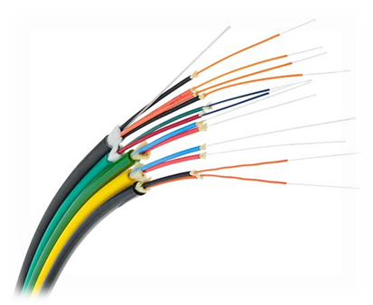
CHAPTER-7
Transmission Media

Slide 2

Introduction
A transmission medium can be broadly defined as anything that can carry information from a source to a destination.
The transmission medium is usually free space (air, vacuum, and water), metallic cable, or fiber-optic cable.

Slide 3
Cont.
In telecommunications, transmission media can be divided into two broad categories:
  (1). Guided
  (2). Unguided.
Guided media include twisted-pair cable, coaxial cable, and fiber-optic cable.
Unguided medium is free space.

Slide 4

Classes of transmission media

Slide 5
7.1 Guided media
Guided media, which are those that provide a channel from one device to another, include twisted-pair cable, coaxial cable, and fiber-optic cable.
Twisted-pair and coaxial cable use metallic (copper) conductors that accept and transport signals in the form of electric current.
Optical fiber is a cable that accepts and transports signals in the form of light.

Slide 6
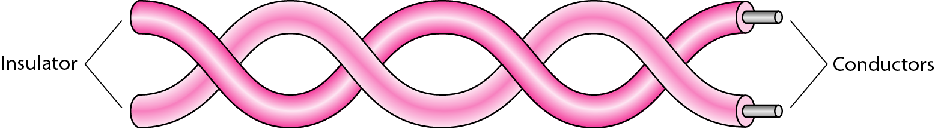
Twisted-Pair Cable
A twisted pair consists of two conductors (normally copper), each with its own plastic insulation, twisted together.

Slide 7

Connectors
The most common UTP connector is RJ45 (RJ stands for registered jack), as shown in Figure 7.5. The RJ45 is a keyed connector, meaning the connector can be inserted in only one way.

Slide 8
Coaxial Cable
Coaxial cable (or coax) carries signals of higher frequency ranges than those in twisted pair cable.
Instead of having two wires, coax has a central core conductor of solid or stranded wire (usually copper) enclosed in an insulating sheath, which is, in turn, encased in an outer conductor of metal foil, braid, or a combination of the two.
The outer metallic wrapping serves both as a shield against noise and as the second conductor, which completes the circuit.
This outer conductor is also enclosed in an insulating sheath, and the whole cable is protected by a plastic cover.

Slide 9

Figure 7.7 Coaxial cable

Slide 10

Coaxial Cable Connectors
To connect coaxial cable to devices, we need coaxial connectors. The most common type of connector used today is the Bayone-Neill-Concelman (BNC) connector.
There are three popular types of these connectors: the BNC connector, the BNC T connector, and the BNC terminator.

Slide 11
Fiber-Optic Cable
A fiber-optic cable is made of glass or plastic and transmits signals in the form of light.
The nature of light:
  Light travels in a straight line.
  If light goes from one substance to another then the ray of light changes direction.
  Ray of light changes direction when goes from more dense to a less dense substance.

Slide 12

Cont.
Angle of Incidence (I): the angle the ray makes with the line perpendicular to the interface between the two substances
Critical Angle: the angle of incidence which provides an angle of refraction of 90-degrees.
Figure 7.10 Fiber optics: Bending of light ray

Slide 13

7.2 Unguided media: Wireless
Unguided media transport electromagnetic waves without using a physical conductor. This type of communication is often referred to as wireless communication. Signals are normally broadcast through free space and thus are available to anyone who has a device capable of receiving them.
Figure 7.17 Electromagnetic spectrum for wireless communication

Slide 14

Unguided media
Wireless transmission waves

Slide 15
Radio Waves
Electromagnetic waves ranging in frequencies between 3 kHz and 1 GHz are normally called radio waves
Electromagnetic waves ranging in frequencies between 1 and 300 GHz are called microwaves.
Radio waves are used for multicast communications, such as radio and television, and paging systems. They can penetrate through walls.
Highly regulated. Use omni directional antennas

Slide 16

Cont.
Omnidirectional Antenna
Radio waves use omnidirectional antennas that send out signals in all directions.
Based on the wavelength, strength, and the purpose of transmission, we can have several types of antennas.

Slide 17
Microwaves
Electromagnetic waves having frequencies between 1 and 300 GHz are called microwaves.
Microwaves are unidirectional. When an antenna transmits microwave waves, they can be narrowly focused. This means that the sending and receiving antennas need to be aligned. The unidirectional property has an obvious advantage. A pair of antennas can be aligned without interfering with another pair of aligned antennas.

Slide 18

Unidirectional Antenna
Microwaves need unidirectional antennas that send out signals in one direction. Two types of antennas are used for microwave communications: the parabolic dish and the horn.

Slide 19
Infrared
Infrared waves, with frequencies from 300 GHz to 400 THz (wavelengths from 1 mm to 770 nm), can be used for short-range communication. Infrared waves, having high frequencies, cannot penetrate walls.
This advantageous characteristic prevents interference between one system and another; a short-range communication system in one room cannot be affected by another system in the next room. When we use our infrared remote control, we do not interfere with the use of the remote by our neighbors. However, this same characteristic makes infrared signals useless for long-range communication. In addition, we cannot use infrared waves outside a building because the sun's rays contain infrared waves that can interfere with the communication.

